Slide 1
Automation Framework
By
Saravanan Kandan

Slide 2
Agenda
Overview of Automation framework
Automation framework architecture
Advantage of this framework
Test cases execution overview
Cucumber report and screenshot
Enhancement required items

Slide 3
Overview of Automation framework
This framework will support both cucumber and TestNg tests.
cucumber is a tool based on Behavior Driven Development (BDD) framework which is used to write acceptance tests for the web application. It allows automation of functional validation in easily readable and understandable format (like plain English) to Business Analysts, Developers, Testers.
I have used java platform to develop this framework and integrated the Selenium webdriver for web automation and Appium for mobile automation.
Framework maintain in the github so every one can access it.
Its generated cucmber report and I had taken screenshot for all steps for verifications.

Slide 4















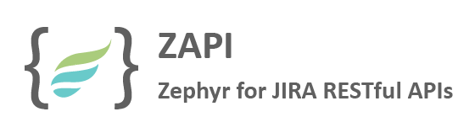
architecture
GitHub
Continuous Integration Server
3
4
Automation Framework
Extract
Check-in
Selenium for Web
Appium for Mobile
Web Portals
Web Portals
6
Update Test Result Repository
Test Management Tool
5
2
Test Status Update
Simulator Transactions
Simulator Transactions
Step 1
1
Manual
Automation

Slide 5
Advantage of this framework
It is helpful to involve business stakeholders who can't easily read code.
It will support to automate all the application like web,Mobile,API,Window based applications.
It will support all the browsers like Chrome,IE,Firefox.
Quick and easy set up and execution.
Execution time also very less
Hilted the specific locator to understand during execution and in report also.

Slide 6
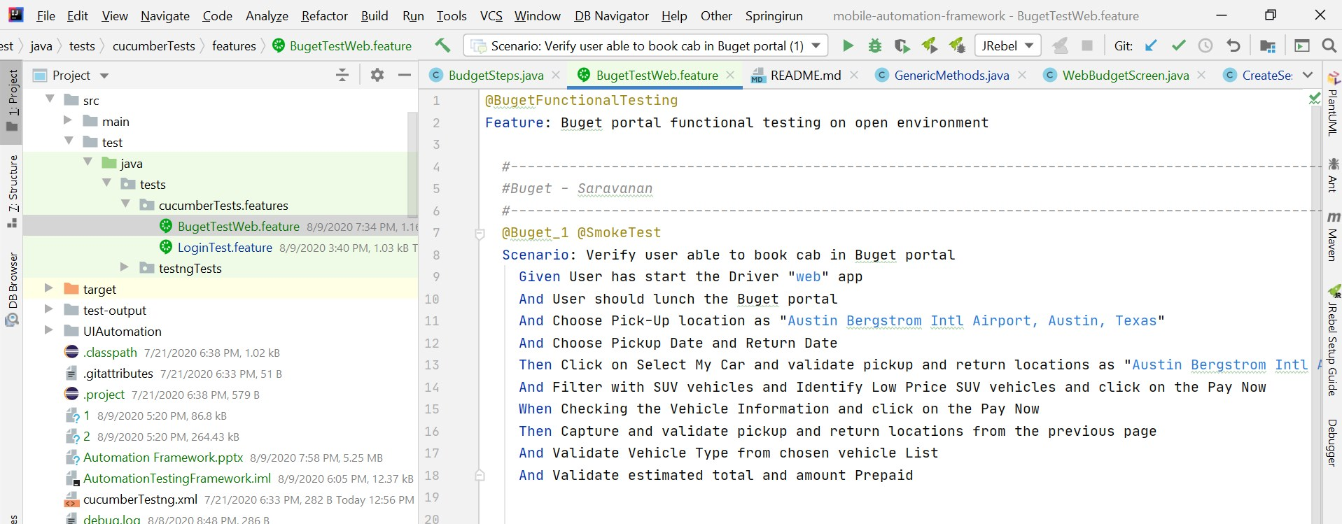
Feature File/ gherkin file

Slide 7
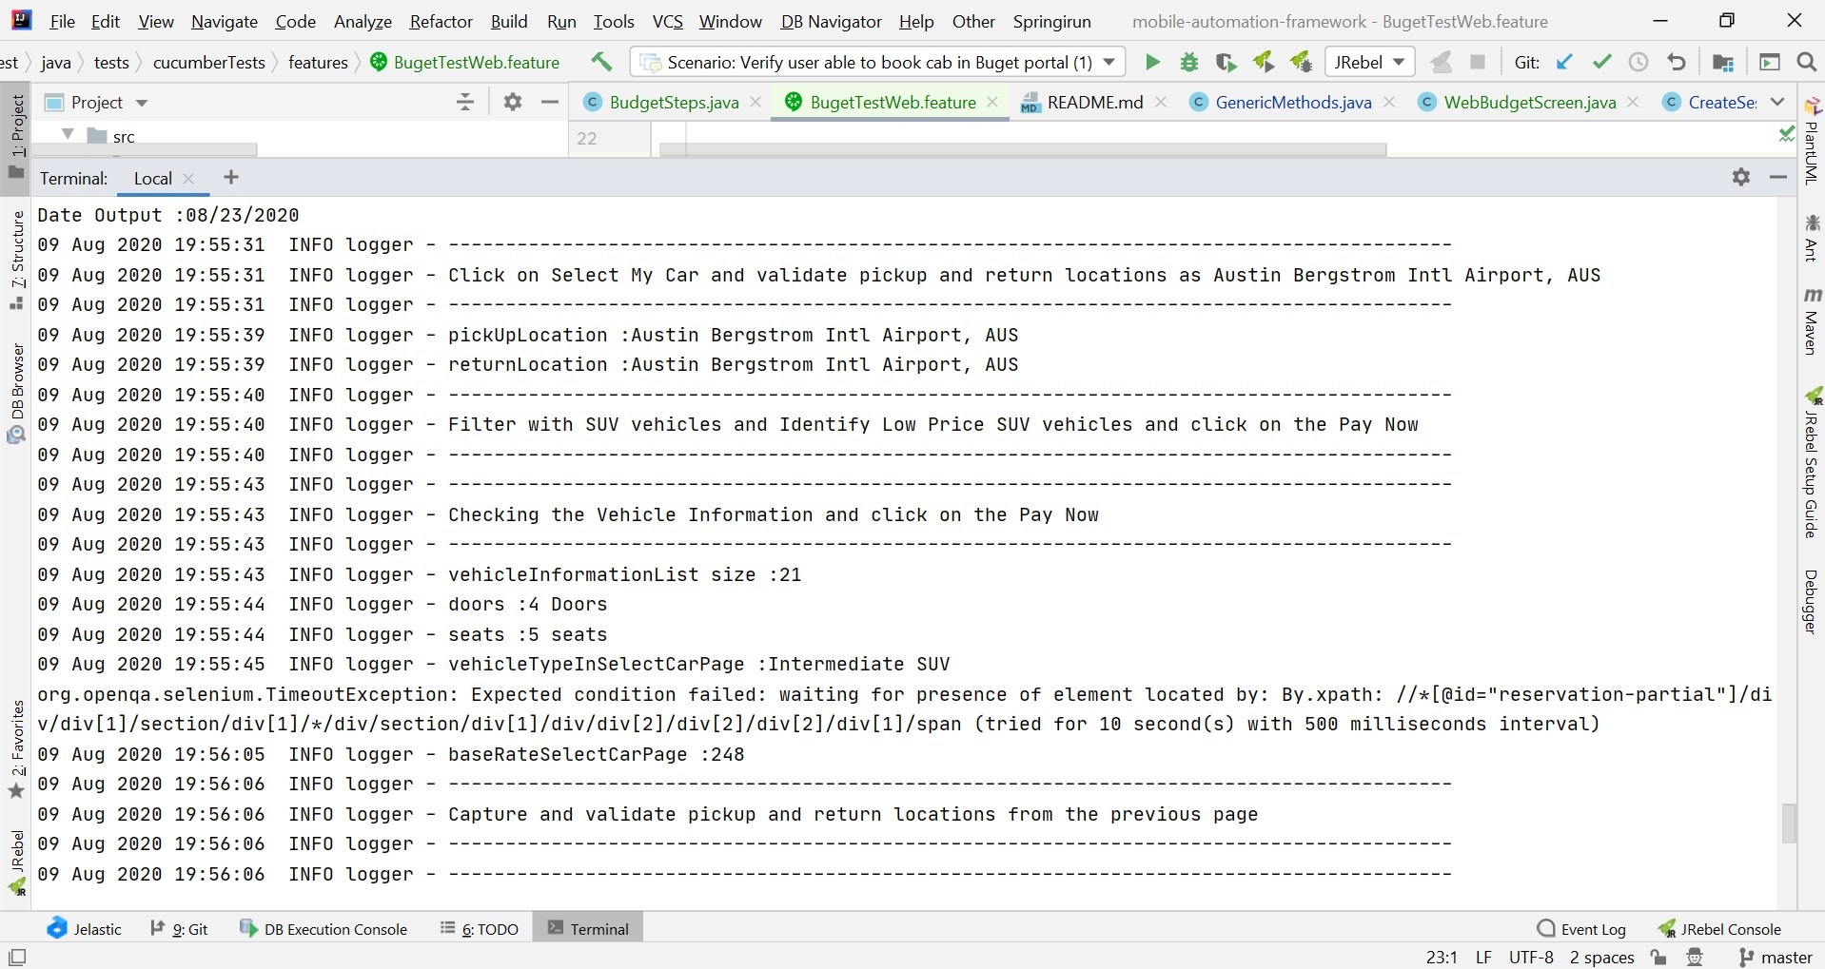
Test cases execution

Slide 8
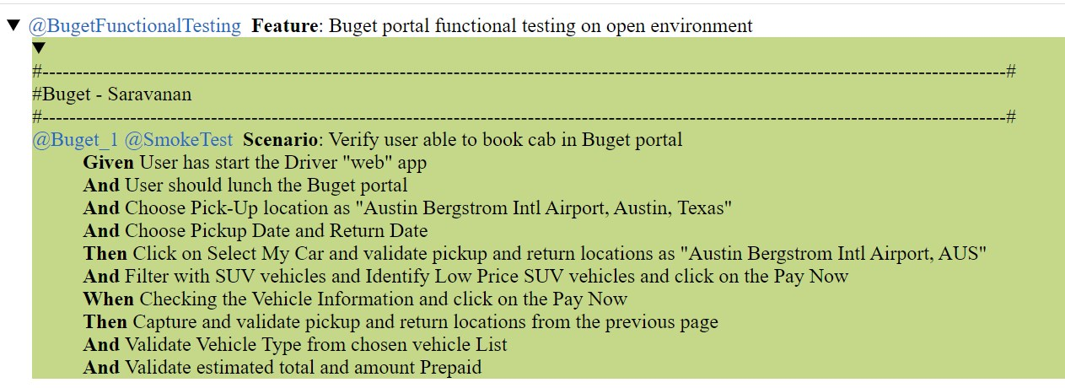
Cucumber report

Slide 9
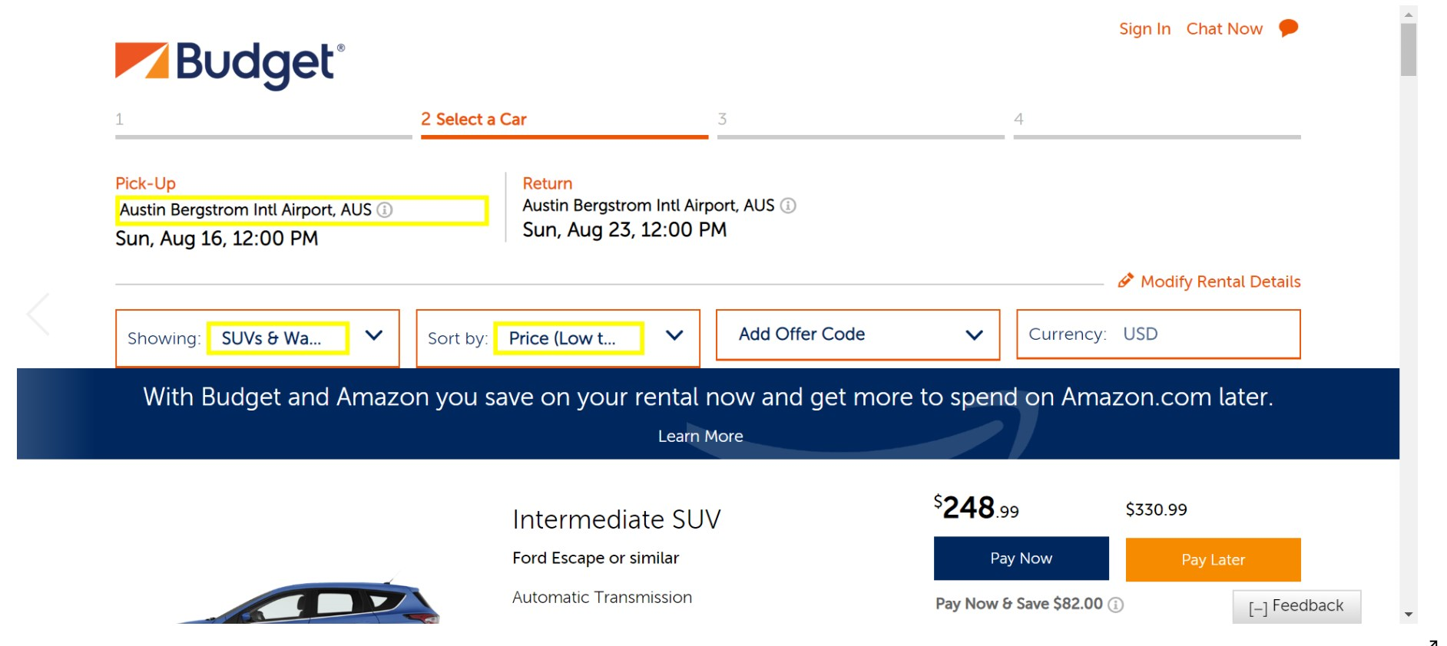
Execution screenshot

Slide 10
Enhancement required items
Below mentions tools need to integrate with this framework in feature
Rest Assured for API automation.
SikuliX for screen based automation Tool.
Extent report to understand all the scenarios , test steps and Screenshot.
Jenkin management tool.
Jira.

Slide 11

By
Saravanan

